Slide 1
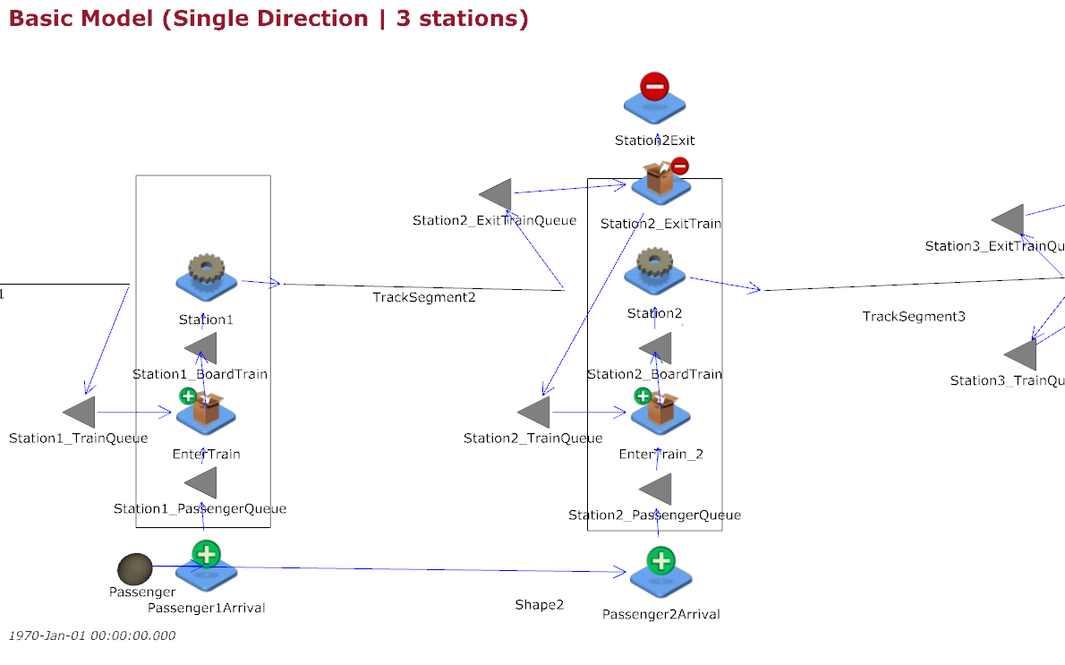
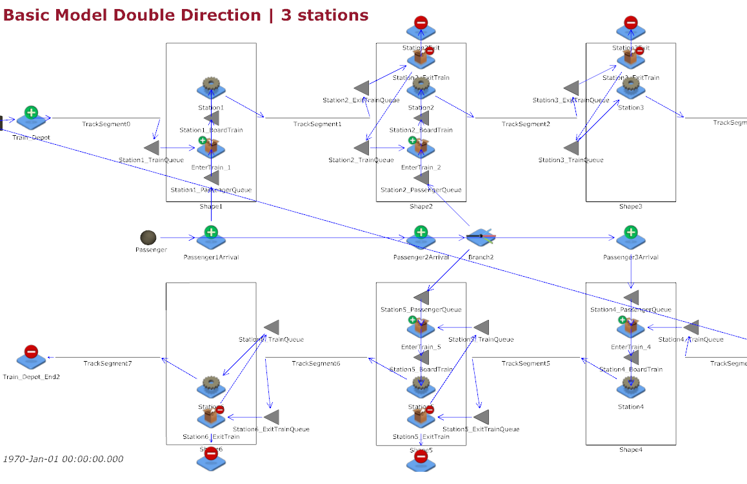
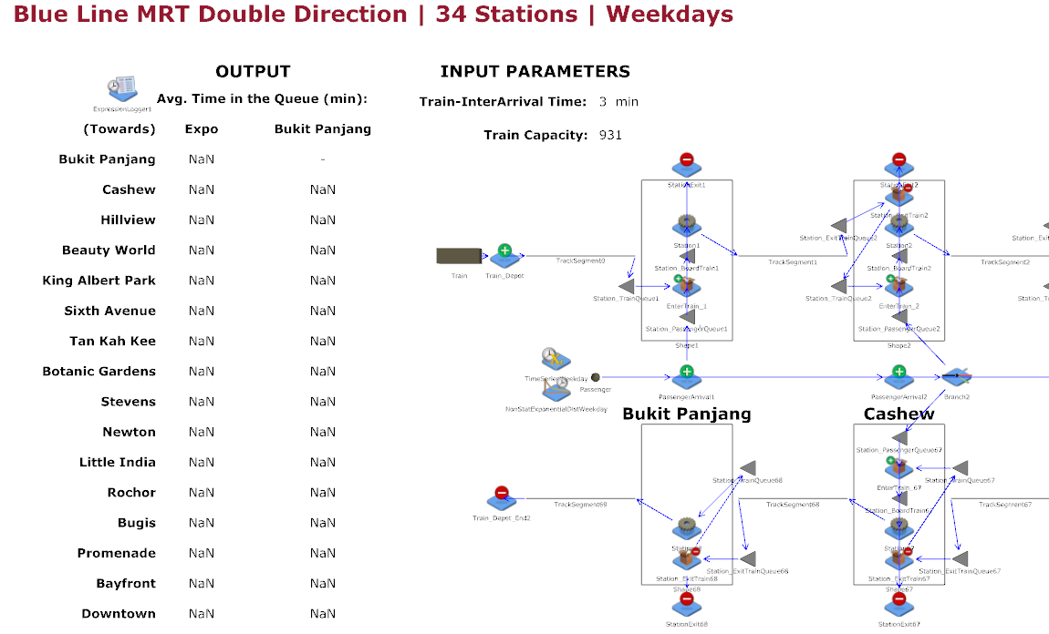
2 Variations of Model
As per our project plan, we have two overall model: simple and complex.
However, there are some sub models too:
Simple Model 1: 3 Stations in 1 direction - 3_Stations_1_Direction.cfg.
Simple Model 2: 3 Stations in 2 directions - 3_Stations_2_Direction.cfg.
Complex Model (Weekdays) : Blue Line in 2 directions (34 Stations) on Weekdays - Blue_Line_Weekday.cfg.
Complex Model (Weekends) : Blue Line in 2 directions (34 Stations) on Weekends - Blue_Line_Weekends.cfg.
For the subsequent slides on the Model Documentation, we will be going through the Complex Model (Weekdays).
40.015 Simulation Modeling and Analysis | Mass Rapid Transit System Line Simulation

Slide 2
Assumptions
For our Complex Model, Blue Line on Weekdays and Weekends (differ only in terms of Passenger Interarrival Times).
Main Assumptions:
Train Interarrival times from the depots are constant parameters, subjected to user input.
Passenger Interarrival times at each station follow an exponential distribution whose rate varies according to the timeframe of the day (Morning Peak hours, Evening Peak hours and Non-peak hours). Different rates for weekdays and weekends too.
Passenger departures at each station is proportional to current train occupancy.
Passenger arrivals at each station alternate between opposite directions.
To generalize and simplify our simulation, train operations are from 0500hrs to 0000hrs for both Weekday and Weekend.
Note most of these assumptions are regarding the parameters of the Simulation model which Land Transport Authority would be able to provide better estimates.
40.015 Simulation Modeling and Analysis | Mass Rapid Transit System Line Simulation

Slide 3
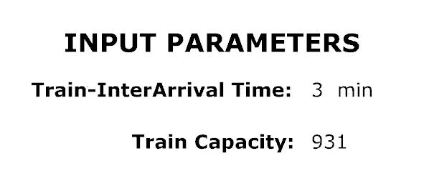
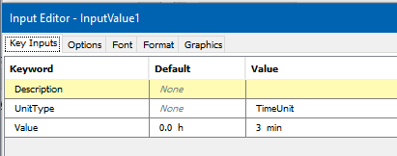
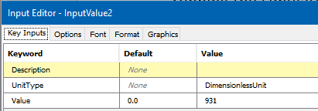
Input Parameters
The Train Interarrival time are parameters that are adjustable by the user before running the simulation using “InputValue”.
Similar for Train Capacity which is set to the current maximum capacity of a medium-capacity MRT line.
40.015 Simulation Modeling and Analysis | Mass Rapid Transit System Line Simulation

Slide 4
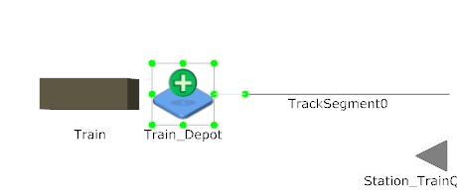
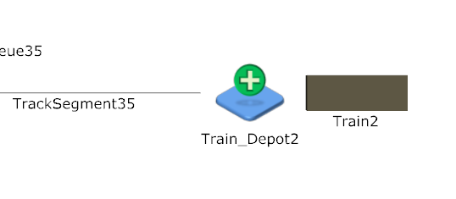
Model Train Arrivals
The container trains are represented by a 3D block.
40.015 Simulation Modeling and Analysis | Mass Rapid Transit System Line Simulation

Slide 5
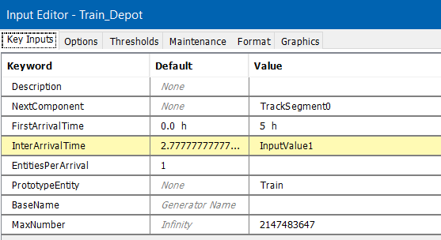
Model Train Arrivals
Similar logic for the Train_Depot2.
Note the InterarrivalTime for the Train Container follows the InputValue1 from the previous slide. First Arrival timing is set to 0500hrs as per operating hour.
Arrivals are 1 by 1.
40.015 Simulation Modeling and Analysis | Mass Rapid Transit System Line Simulation

Slide 6
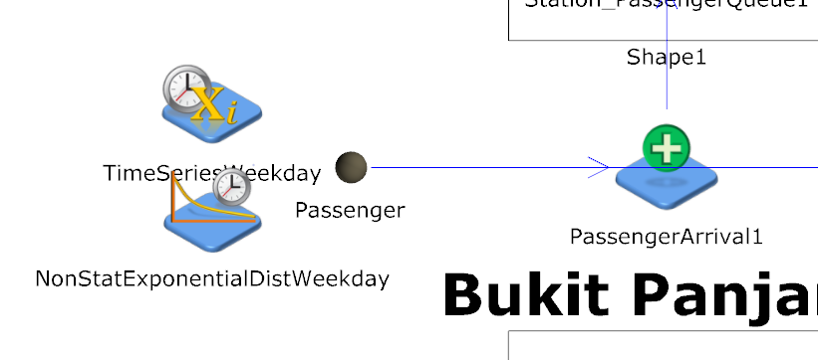
Passenger Arrivals
The entity passenger is represented by a 3D sphere.
Note for subsequent slides, the blue arrows represent the entities flow.
40.015 Simulation Modeling and Analysis | Mass Rapid Transit System Line Simulation

Slide 7
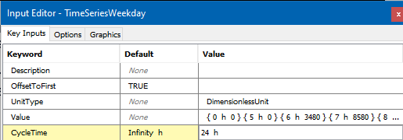
Passenger Arrivals
For example, the estimated average number of passenger arrivals per hour are as follows: 5100 (morning peak, 0600hrs – 0900hrs), 7980 (evening peak, 1900hrs – 2100hrs ) and 3480 (non-peak).
Hence the expected cumulative number of passenger arrivals would be { 0 h 0 } { 05 h 0 } { 06 h 3480 } { 07 h 3480+5100 } …
Timeseries of the expected cumulative number of passenger arrivals as a function of time over a day.
The given example is for the Weekday version; hence the values will differ for the Weekend version.
40.015 Simulation Modeling and Analysis | Mass Rapid Transit System Line Simulation

Slide 8
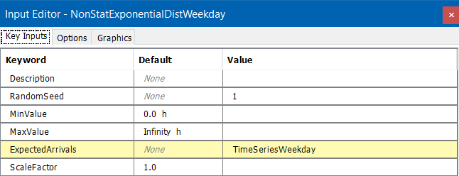
Passenger Arrivals
As mentioned, the expected arrivals for the exponential distribution takes in values from the Timeseries.
40.015 Simulation Modeling and Analysis | Mass Rapid Transit System Line Simulation

Slide 9
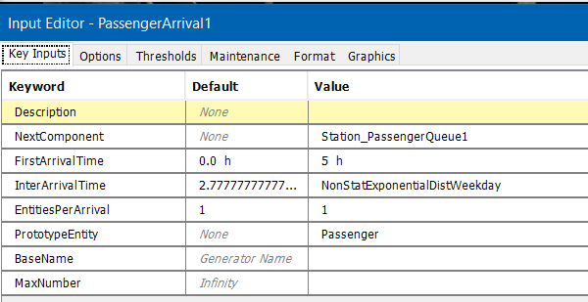
Passenger Arrivals
The arrivals are 1 by 1.
Interarrival time follows the NonStatExponential Distribution.
Note the First Arrival Time will be further discussed in later slides under Passenger Queues.
40.015 Simulation Modeling and Analysis | Mass Rapid Transit System Line Simulation

Slide 10
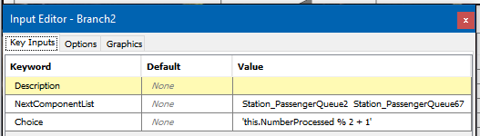
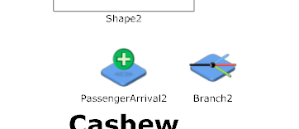
Passenger Arrivals
The passengers arriving at the middle stations can choose either of the two directions to travel.
Assumption: The arriving passengers will enter the both direction queues alternatively (1st passenger enters the queue towards Expo, then the 2nd passenger towards Bukit Panjang, 3rd passenger towards Expo, …)
E.g. “this.NumberProcessed % 2 + 1”:
1 modulo 2 + 1 = 2
2 modulo 2 + 1 = 1
3 modulo 2 + 1 = 2
…
For the 2 extreme end stations (Top picture), there is no branching unlike the middle stations (Bottom picture) where the passengers arriving have two directions of trains to board.
40.015 Simulation Modeling and Analysis | Mass Rapid Transit System Line Simulation

Slide 11
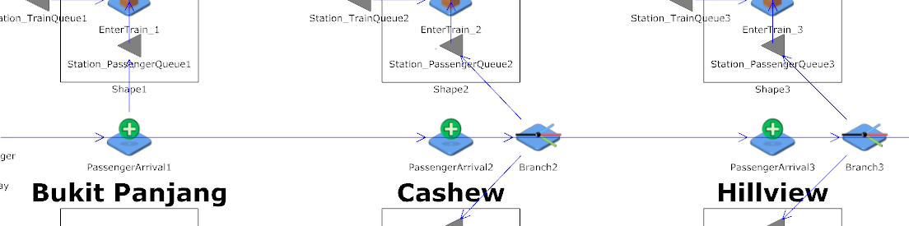
Passenger Queues
Problem 1:
Note for all stations, the PassengerArrival entity generator starts from 0500hrs. However, the 1st train that leaves the depot at 0500hrs towards Expo only arrives at the 1st station (Bukit Panjang) at 0503hrs, 2nd station (Cashew) at 0504hrs, 3rd station (Hillview) at 0506hrs …
Hence passengers at the last few stations towards Expo will be waiting for very long since they begin queuing from 0500hrs but the 1st train only arrives around 0600hrs.
40.015 Simulation Modeling and Analysis | Mass Rapid Transit System Line Simulation

Slide 12
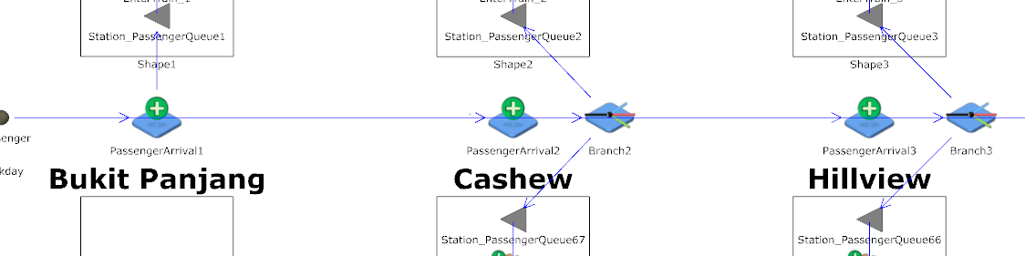
Passenger Queues
Problem 2:
Note for middle stations, the PassengerArrival starts from 0500hrs. However, the 1st train that leaves the depot at 0500hrs towards Expo only arrives at the 2nd station (Cashew) at 0504hrs. At the same time, the 1st train that leaves the depot at 0500hrs towards Bukit Panjang arrives at the 2nd last station (Cashew) at 0608hrs …
Hence passengers generating for Cashew for example, should only enter the queue towards Expo from 0504hrs onwards and towards Bukit Panjang from 0608hrs.
40.015 Simulation Modeling and Analysis | Mass Rapid Transit System Line Simulation

Slide 13
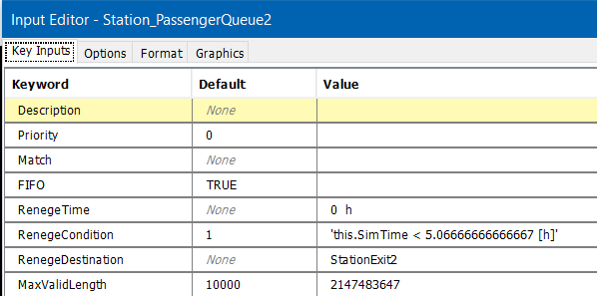
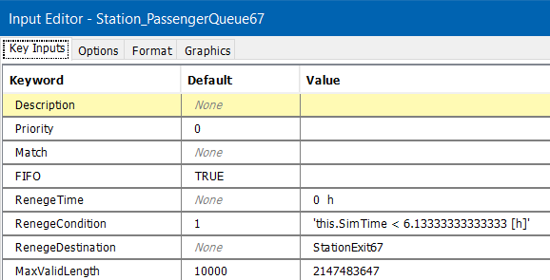
Passenger Queues
Solution to both problems: (For example Cashew Station)
We make use of reneging, whereby any passenger arriving before the 1st train arrives at the station in that direction will be reneged.
The passengers who are reneged, would simply be sent to their respective station entity sinks for removal.
40.015 Simulation Modeling and Analysis | Mass Rapid Transit System Line Simulation

Slide 14
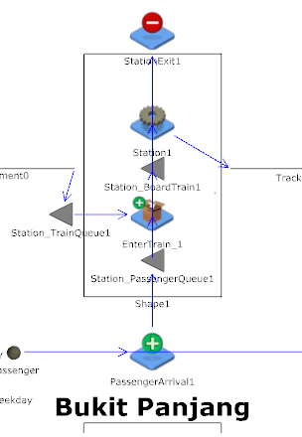
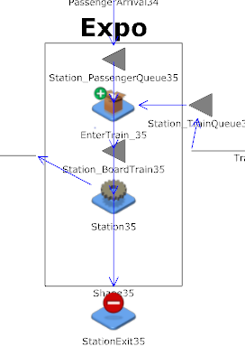
Passenger Queues
Note for the 1st stations from both sides:
Even though the passengers only board the train, there is an entity sink for the reneged passengers to exit.
40.015 Simulation Modeling and Analysis | Mass Rapid Transit System Line Simulation

Slide 15
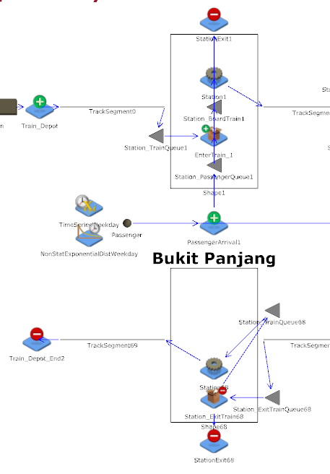
Extreme End Stations
The two stations are: Expo and Bukit Panjang. Similar logic for both stations.
Two rectangular shapes to represent both sides of the MRT platforms going in the opposite direction. For example, Bukit Panjang: The top shape represents it as the 1st station and the bottom shape represents the last station of the line.
The station name is in bold.
Note the shapes are not mirror images. This is because passengers only board at the 1st station and only alight at the last station.
40.015 Simulation Modeling and Analysis | Mass Rapid Transit System Line Simulation

Slide 16
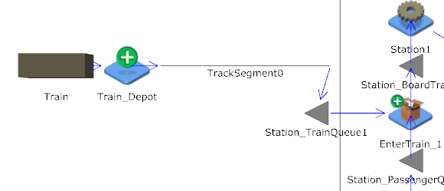
Extreme End Stations – 1st Station
As the 1st station, the trains come directly from the Train_Depot.
40.015 Simulation Modeling and Analysis | Mass Rapid Transit System Line Simulation

Slide 17
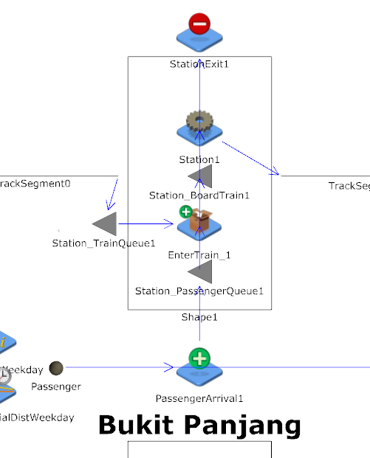
Extreme End Stations – 1st Station
For the extreme stations, there is no branching as arriving passengers only enter 1 queue towards the other end.
40.015 Simulation Modeling and Analysis | Mass Rapid Transit System Line Simulation

Slide 18
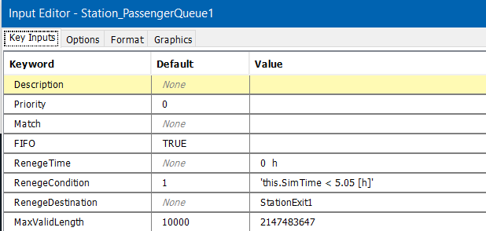
Extreme End Stations – 1st Station
The Queue is FIFO basis and the maximum number of passengers in the queue is kept to be the largest number possible. This assumes there is no limit on the number of passengers on the MRT platforms.
40.015 Simulation Modeling and Analysis | Mass Rapid Transit System Line Simulation

Slide 19
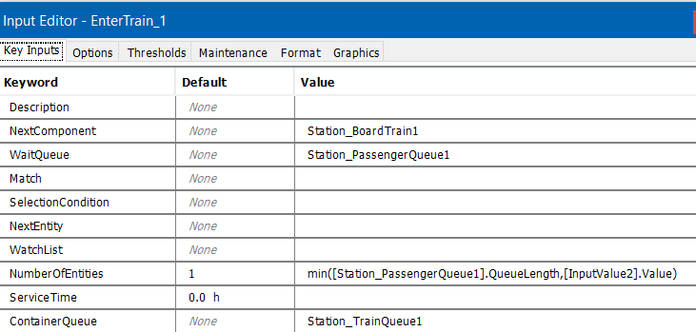
Extreme End Stations – 1st Station
The Packing takes in Passenger entity from the Passenger Queue and the Container, Train is from the Train Queue.
40.015 Simulation Modeling and Analysis | Mass Rapid Transit System Line Simulation

Slide 20
Extreme End Stations – 1st Station
The number of Passengers to be packed into the Train is the minimum between the number of Passengers in the queue and train maximum capacity (InputValue2).
This is to ensure that if the train is full, no passengers are allowed to board the train.
40.015 Simulation Modeling and Analysis | Mass Rapid Transit System Line Simulation

Slide 21
Extreme End Stations – 1st Station
The next component for the Train filled with passengers is the boarding queue to enter the server, Station1, where we simulate the duration that the train doors are kept open.
40.015 Simulation Modeling and Analysis | Mass Rapid Transit System Line Simulation

Slide 22
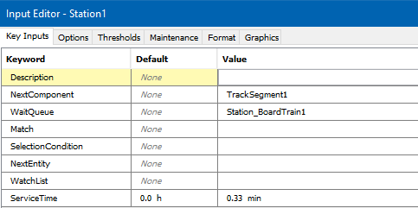
Extreme End Stations – 1st Station
As mentioned earlier, the ServiceTime of 0.33 min is to simulate the duration that the train doors are kept open.
The ServiceTime is assumed to be 0.33 min for every station.
40.015 Simulation Modeling and Analysis | Mass Rapid Transit System Line Simulation

Slide 23
Extreme End Stations – 1st Station
The next component for the Train with passengers would simply be the next Station.
40.015 Simulation Modeling and Analysis | Mass Rapid Transit System Line Simulation

Slide 24
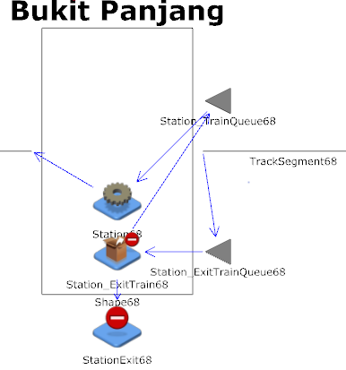
Extreme End Stations – Last Station
As the last station, the trains come from the 2nd last station and enter the queue to be unpacked.
40.015 Simulation Modeling and Analysis | Mass Rapid Transit System Line Simulation

Slide 25
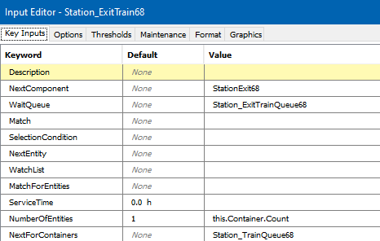
Extreme End Stations – Last Station
Since this is the last station, all the passengers in the Train container should exit (unpack). Hence the maximum number of entities to be removed is set to be the number of passengers in the train.
40.015 Simulation Modeling and Analysis | Mass Rapid Transit System Line Simulation

Slide 26
Extreme End Stations – Last Station
The next component for the passenger entities who exited the train would be the StationExit entity sink.
40.015 Simulation Modeling and Analysis | Mass Rapid Transit System Line Simulation

Slide 27
Extreme End Stations – Last Station
The next component for the empty Train would be the queue to enter the Station Server where we once again simulate the duration that the doors are open.
40.015 Simulation Modeling and Analysis | Mass Rapid Transit System Line Simulation

Slide 28
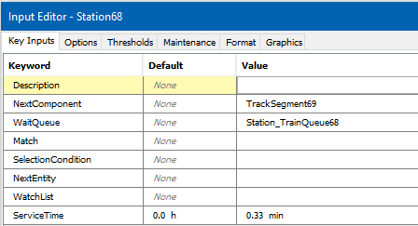
Extreme End Stations – Last Station
As assumed earlier, the ServiceTime is 0.33 min.
40.015 Simulation Modeling and Analysis | Mass Rapid Transit System Line Simulation

Slide 29
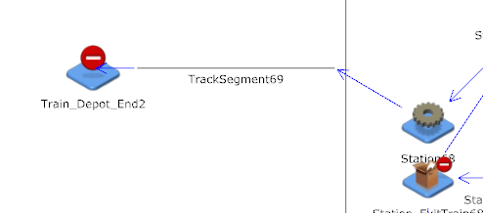
Extreme End Stations – Last Station
The next component for the empty Train would simply be the Train_Depot_End2 sink.
40.015 Simulation Modeling and Analysis | Mass Rapid Transit System Line Simulation

Slide 30
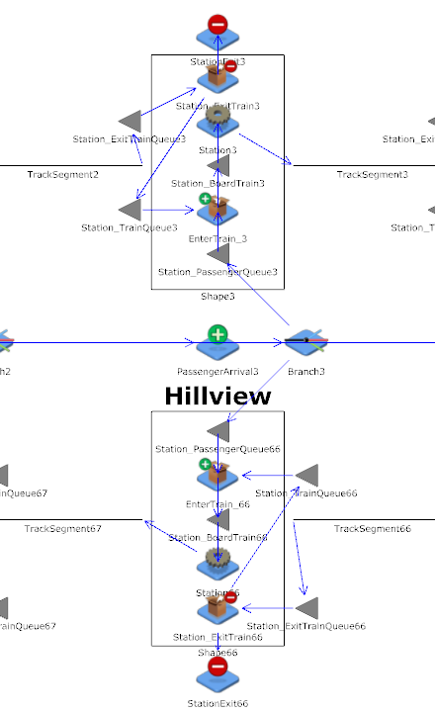
Middle Stations
The remaining middle stations have similar logic and hence are repetitive.
Two rectangular shapes to represent both sides of the MRT platforms going in the opposite directions.
The station name is in bold.
Note the middle stations’ shapes are mirror images. The reason is that unlike the Extreme End Stations, the passengers can choose to exit or board the trains for either direction.
Note due to the limitations of JaamSim in copying and pasting multiple objects, we edited the model config file directly in Visual Code Studio with the help of R programming language instead.
40.015 Simulation Modeling and Analysis | Mass Rapid Transit System Line Simulation

Slide 31
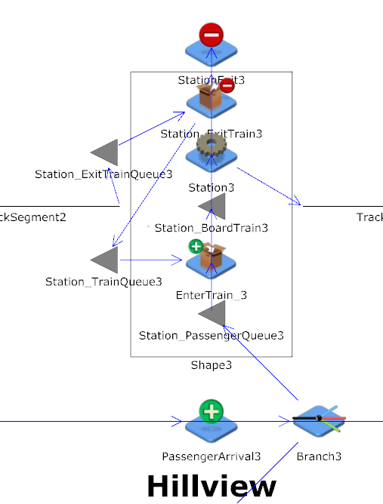
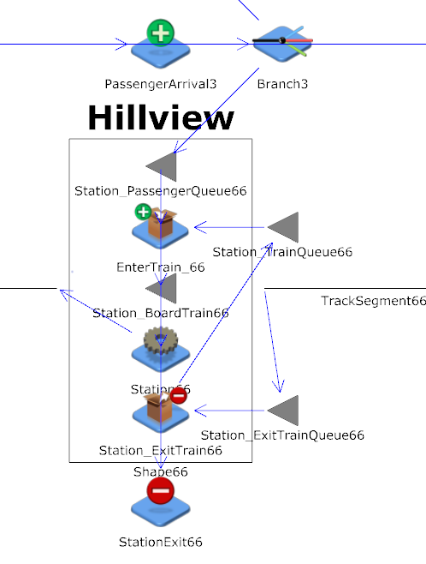
Middle Stations
For every middle station, both shapes are a mirror image of the other, both pointing in opposite direction of travel.
40.015 Simulation Modeling and Analysis | Mass Rapid Transit System Line Simulation

Slide 32
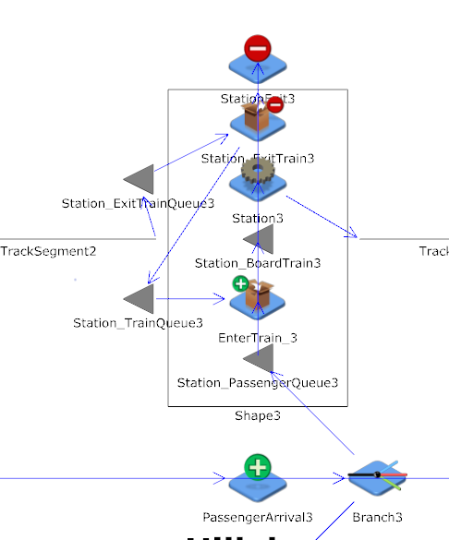
Middle Stations
For the middle stations, the trains arrive from the previous station and enters Station_ExitTrainQueue3, the queue for passengers to exit after unpacking.
40.015 Simulation Modeling and Analysis | Mass Rapid Transit System Line Simulation

Slide 33
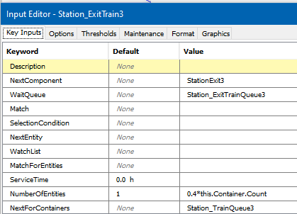
Middle Stations
For this unpacking, only some of the passengers in the Train will exit (unpack).
Assumption is that 40% of the passengers will leave the train, which can be changed too.
40.015 Simulation Modeling and Analysis | Mass Rapid Transit System Line Simulation

Slide 34
Middle Stations
The next component for the passenger entities who exit the train would be the StationExit3 entity sink.
40.015 Simulation Modeling and Analysis | Mass Rapid Transit System Line Simulation

Slide 35
Middle Stations
The next component for the Train with the remaining passengers would be the Station_TrainQueue3, the queue for passengers to enter (packing).
40.015 Simulation Modeling and Analysis | Mass Rapid Transit System Line Simulation

Slide 36
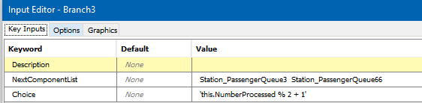
Middle Stations
As mentioned under Slide Passenger Arrivals, the passengers arriving at the middle stations will alternatively branch to both directions.
Assumption : The arriving passengers will enter the both direction queues alternatively (1st passenger enters the queue towards Expo, then the 2nd passenger towards Bukit Panjang, 3rd passenger towards Expo,…)
E.g. “this.NumberProcessed % 2 + 1”:
1 modulo 2 + 1 = 2
2 modulo 2 + 1 = 1
3 modulo 2 + 1 = 2
…
40.015 Simulation Modeling and Analysis | Mass Rapid Transit System Line Simulation

Slide 37
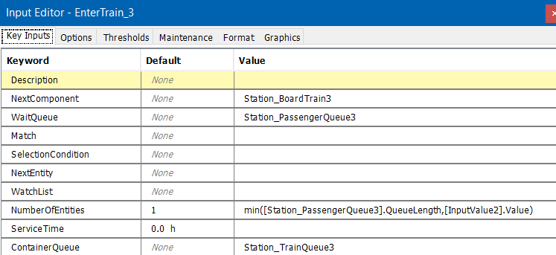
Middle Stations
The Packing takes in Passenger entity from the Passenger Queue and the Container, Train is from the Train Queue which has the remaining on-board passengers.
40.015 Simulation Modeling and Analysis | Mass Rapid Transit System Line Simulation

Slide 38
Middle Stations
As before, the number of Passengers to be packed into the Train is the minimum between the number of Passengers in the queue and train maximum capacity (InputValue2).
This is to ensure that if the train is full, no passengers are allowed to board the train.
40.015 Simulation Modeling and Analysis | Mass Rapid Transit System Line Simulation

Slide 39
Middle Stations
The next component for the Train filled with passengers is the boarding queue to enter the server, Station3, where we simulate the duration that the doors of the train are kept open.
40.015 Simulation Modeling and Analysis | Mass Rapid Transit System Line Simulation

Slide 40
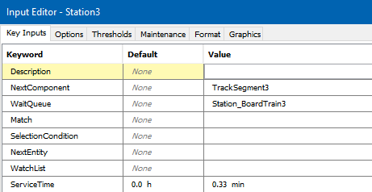
Middle Stations
As mentioned earlier, the ServiceTime is 0.33 min.
40.015 Simulation Modeling and Analysis | Mass Rapid Transit System Line Simulation

Slide 41
Middle Stations
The next component for the Train with passengers would simply be the next Station.
40.015 Simulation Modeling and Analysis | Mass Rapid Transit System Line Simulation

Slide 42
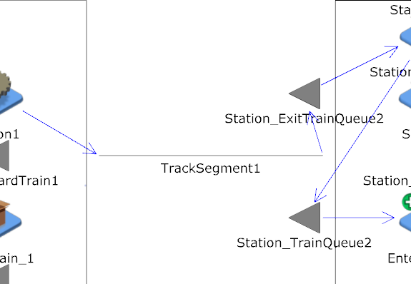
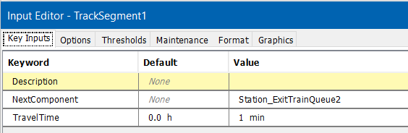
Train Tracks Timings
TrackSegment entity conveyers simulate the travelling between the stations, the travel times are taken from the travel timing boards at the MRT Stations.
40.015 Simulation Modeling and Analysis | Mass Rapid Transit System Line Simulation

Slide 43
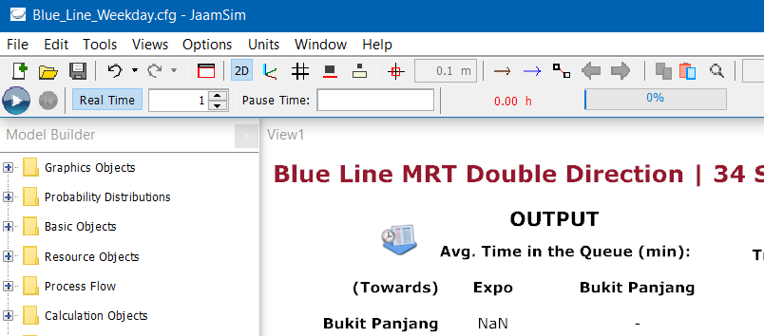

Simulation Run
We declared the following attributes for the Simulation Object in the configuration file of the blue line models.
Therefore, the simulation run time will be a day (1440 min) as forementioned.
In addition, the number of replications is currently set to 2. Hence after pressing the “Run” button, the simulation will run once first and then reset automatically and run again for a second time.
For Output Analysis we will be increasing the number of repetitions to 100 to provide a better overall estimate after averaging.
40.015 Simulation Modeling and Analysis | Mass Rapid Transit System Line Simulation

Slide 44
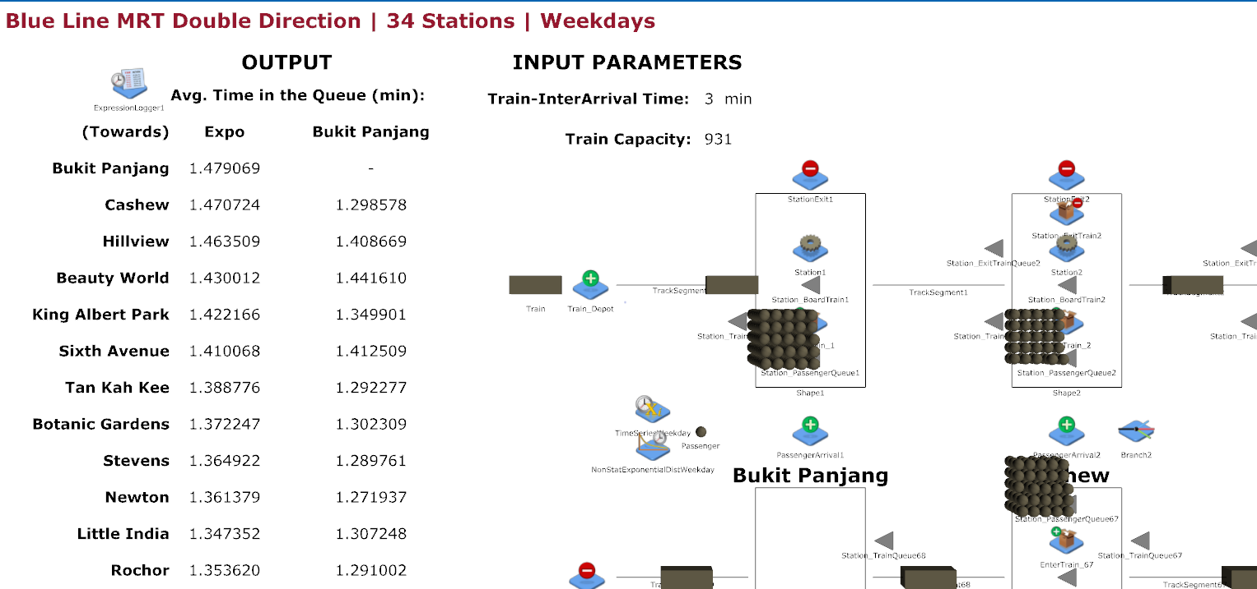
Interface
Input
Output
40.015 Simulation Modeling and Analysis | Mass Rapid Transit System Line Simulation

Slide 45
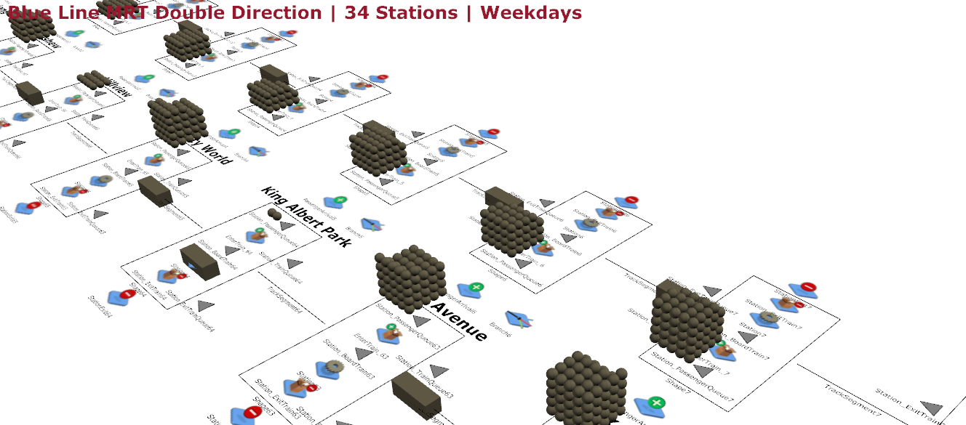
Run the Model
MRT Train
Passengers
40.015 Simulation Modeling and Analysis | Mass Rapid Transit System Line Simulation

